Slide 1
UCS1601
DATA WAREHOUSING AND DATA MINING

Slide 2
INSTITUTE VISION AND MISSION
VISION
To achieve a prominent position among the top technical institutions.
MISSION
M1: To bestow standard technical education par excellence through state of the art infrastructure, competent faculty and high ethical standards.
M2: To nurture research and entrepreneurial skills among students in cutting edge technologies.
M3: To provide education for developing high-quality professionals to transform the society.

Slide 3
DEPARTMENT VISION AND MISSION
VISION
To create eminent professionals of Computer Science and Engineering by imparting quality education.
MISSION
M1: To provide technical exposure in the field of Computer Science and Engineering through state of the art infrastructure and ethical standards.
M2: To engage the students in research and development activities in the field of Computer Science and Engineering.
M3: To empower the learners to involve in industrial and multi-disciplinary projects for addressing the societal needs.

Slide 4
PROGRAM OUTCOMES (Pos): Engineering Graduates will be able to:
Engineering knowledge: Apply the knowledge of mathematics, science, engineering fundamentals and an engineering specialization to the solution of complex engineering problems.
Problem analysis: Identify, formulate, review research literature, and analyze complex engineering problems reaching substantiated conclusions using first principles of mathematics, natural sciences, and engineering sciences.

Slide 5
3. Design/development of solutions: Design solutions for complex engineering problems and design system components or processes that meet the specified needs with appropriate consideration for the public health and safety, and the cultural, societal, and environmental considerations.
Conduct investigations of complex problems: Use research-based knowledge and research methods including design of experiments, analysis and interpretation of data, and synthesis of the information to provide valid conclusions.
Modern tool usage: Create, select, and apply appropriate techniques, resources, and modern engineering and IT tools including prediction and modeling to complex engineering activities with an understanding of the limitations.

Slide 6
6. The engineer and society: Apply reasoning informed by the contextual knowledge to assess societal, health, safety, legal and cultural issues and the consequent responsibilities relevant to the professional engineering practice.
7. Environment and sustainability: Understand the impact of the professional engineering solutions in societal and environmental contexts, and demonstrate the knowledge of, and need for sustainable development.
8. Ethics: Apply ethical principles and commit to professional ethics and responsibilities and norms of the engineering practice.
9. Individual and team work: Function effectively as an individual, and as a member or leader in diverse teams, and in multidisciplinary settings.

Slide 7
10.Communication: Communicate effectively on complex engineering activities with the engineering community and with society at large, such as, being able to comprehend and write effective reports and design documentation, make effective presentations, and give and receive clear instructions.
11.Project management and finance: Demonstrate knowledge and understanding of the engineering and management principles and apply these to one‘s own work, as a member and leader in a team, to manage projects and in multidisciplinary environments.
12.Life-long learning: Recognize the need for, and have the preparation and ability to engage in independent and life-long learning in the broadest context of technological change.

Slide 8
Programme Outcome (PO)
YEAR III | SEMESTER I | COURSE TITLE | Program Outcome(PO)
 |  |  | 1 | 2 | 3 | 4 | 5 | 6 | 7 | 8 | 9 | 10 | 11 | 12
 |  | DATA WAREHOUSING AND DATA MINING | √ | √ | √ |  |  |  |  |  | √

Slide 9
Course Outcome (CO)
OUTCOMES:
Upon completion of the course, the students will be able to
Demonstrate the concepts of data warehouse and mining.
Experiment with data mining and data preprocessing.
Organize frequent item sets and perform classification.
Outline the basic partitioning and clustering analysis.
Interpret and learn WEKA tool along with its applications.

Slide 10
Upon the Completion of the Corse, the students will be able to
Course Outcomes | Description | Level in Bloom’s Taxonomy
CO1 | Demonstrate the concepts of data warehouse and mining. | K2
CO2 | Experiment with data mining and data preprocessing. | K3
CO3 | Organize frequent itemsets and perform classification. | K3
CO4 | Outline the basic partitioning and clustering analysis. | K2
CO5 | Interpret and learn WEKA tool along with its applications. | K2
Correlation between outcomes (CO) and Program outcomes(POs)
Subject Code & Name | Course Outcomes | K2 | K3 | K3 | K2 | K2 | A2 | A3 | A2 | A2 | A2 | A3 | A3 | PSO1 | PSO2
UCB1401/ DATABASE MANAGEMENT SYSTEMS |  | PO1 | PO2 | PO3 | PO4 | PO5 | PO6 | PO7 | PO8 | PO9 | PO10 | PO11 | PO12
 | C312.1 | 3 | 3 | 3 | - | - | - | - | - | 2 | - | - | 1 | 2 | -
 | C312.2 | 3 | 3 | 3 | 1 | 2 | - | - | - | 2 | - | - | 1 | 3 | 2
 | C312.3 | 3 | 3 | 3 | 1 | 2 | - | - | - | 2 | - | - | 1 | 3 | 2
 | C312.4 | 3 | 3 | 3 | 1 | 2 | - | - | - | 2 | - | - | 1 | 2 | 1
 | C312.5 | 3 | 3 | 3 | - | 2 | - | - | - | 2 | - | - | 1 | 2 | 2

Slide 11
TEXT BOOK:
Jiawei Han and Micheline Kamber, “Data Mining Concepts and Techniques”, 3rd Edition, Elsevier, Reprinted 2012.
REFERENCES:
Alex Berson and Stephen J. Smith, “Data Warehousing, Data Mining & OLAP”, Tata McGraw – Hill Edition, 27th Reprint 2013.
Panging Tan, Michael Steinbach and Vipin Kumar, “Introduction To Data Mining”, Pearson Education, 2016.
Ian Witten, Eibe Frank, Mark Hall, Christopher Pal, “Data Mining: Practical Machine Learning Tools and Techniques”, Elsevier, 4th Edition, 2016.
K.P. Soman, Shyam Diwakar and V. Ajay, “Insight into Data Mining Theory and Practice”, Eastern Economy Edition, Prentice Hall of India, 2006.

Slide 12
UNIT-I INTRODUCTION
Data mining – data warehousing – data warehouse models – metadata – data cube: a multidimensional data model – schemas for multidimensional data model – dimensions measures – OLAP: types of OLAP – ROLAP, MOLAP, HOLAP.

Slide 13
Why Data Mining?
The Explosive Growth of Data: from terabytes to petabytes
Data collection and data availability
Automated data collection tools, database systems, Web, computerized society
Major sources of abundant data
Business: Web, e-commerce, transactions, stocks, …
Science: Remote sensing, bioinformatics, scientific simulation, …
Society and everyone: news, digital cameras, YouTube
We are drowning in data, but starving for knowledge!
“Necessity is the mother of invention”—Data mining—Automated analysis of massive data sets

Slide 14
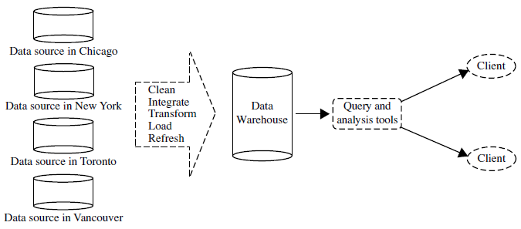
What Kinds of Data Can Be Mined?

Slide 15
What Is Data Mining?
Data mining (knowledge discovery from data)
Extraction of interesting (non-trivial, implicit, previously unknown and potentially useful) patterns or knowledge from huge amount of data
Data mining: a misnomer?
Alternative names
Knowledge discovery (mining) in databases (KDD), knowledge extraction, data/pattern analysis, data archeology, data dredging, information harvesting, business intelligence, etc.
Watch out: Is everything “data mining”?
Simple search and query processing
(Deductive) expert systems

Slide 16
Knowledge Discovery (KDD) Process
This is a view from typical database systems and data warehousing communities
Data mining plays an essential role in the knowledge discovery process
Knowledge
Pattern Evaluation
Data Mining
Task-relevant Data
Data Warehouse
Selection
Data Cleaning
Data Integration
Databases

Slide 17
Example: A Web Mining Framework
Web mining usually involves
Data cleaning
Data integration from multiple sources
Warehousing the data
Data cube construction
Data selection for data mining
Data mining
Presentation of the mining results
Patterns and knowledge to be used or stored into knowledge-base

Slide 18
Data Mining in Business Intelligence
Increasing potential
to support
business decisions
End User
Decision Making
Data Presentation
Business
Analyst
Visualization Techniques
Data Mining
Data
Analyst
Information Discovery
Data Exploration
Statistical Summary, Querying, and Reporting
Data Preprocessing/Integration, Data Warehouses
Data Sources
DBA
Paper, Files, Web documents, Scientific experiments, Database Systems

Slide 19
Example: Medical Data Mining
Health care & medical data mining – often adopted such a view in statistics and machine learning
Preprocessing of the data (including feature extraction and dimension reduction)
Classification or/and clustering processes
Post-processing for presentation

Slide 20
Multi-Dimensional View of Data Mining
Data to be mined
Database data (extended-relational, object-oriented, heterogeneous, legacy), data warehouse, transactional data, stream, spatiotemporal, time-series, sequence, text and web, multi-media, graphs & social and information networks
Knowledge to be mined (or: Data mining functions)
Characterization, discrimination, association, classification, clustering, trend/deviation, outlier analysis, etc.
Descriptive vs. predictive data mining
Multiple/integrated functions and mining at multiple levels
Techniques utilized
Data-intensive, data warehouse (OLAP), machine learning, statistics, pattern recognition, visualization, high-performance, etc.
Applications adapted
Retail, telecommunication, banking, fraud analysis, bio-data mining, stock market analysis, text mining, Web mining, etc.

Slide 21
Data Mining: On What Kinds of Data?
Database-oriented data sets and applications
Relational database, data warehouse, transactional database
Advanced data sets and advanced applications
Data streams and sensor data
Time-series data, temporal data, sequence data (incl. bio-sequences)
Structure data, graphs, social networks and multi-linked data
Object-relational databases
Heterogeneous databases and legacy databases
Spatial data and spatiotemporal data
Multimedia database
Text databases
The World-Wide Web

Slide 22
What is a Data Warehouse?
Defined in many different ways, but not rigorously.
A decision support database that is maintained separately from the organization’s operational database
Support information processing by providing a solid platform of consolidated, historical data for analysis.
“A data warehouse is a subject-oriented, integrated, time-variant, and nonvolatile collection of data in support of management’s decision-making process.”—W. H. Inmon
Data warehousing:
The process of constructing and using data warehouses

Slide 23
Data Warehouse—Subject-Oriented
Organized around major subjects, such as customer, product, sales
Focusing on the modeling and analysis of data for decision makers, not on daily operations or transaction processing
Provide a simple and concise view around particular subject issues by excluding data that are not useful in the decision support process

Slide 24
Data Warehouse—Integrated
Constructed by integrating multiple, heterogeneous data sources
relational databases, flat files, on-line transaction records
Data cleaning and data integration techniques are applied.
Ensure consistency in naming conventions, encoding structures, attribute measures, etc. among different data sources
E.g., Hotel price: currency, tax, breakfast covered, etc.
When data is moved to the warehouse, it is converted.

Slide 25
Data Warehouse—Time Variant
The time horizon for the data warehouse is significantly longer than that of operational systems
Operational database: current value data
Data warehouse data: provide information from a historical perspective (e.g., past 5-10 years)
Every key structure in the data warehouse
Contains an element of time, explicitly or implicitly
But the key of operational data may or may not contain “time element”

Slide 26
Data Warehouse—Nonvolatile
A physically separate store of data transformed from the operational environment
Operational update of data does not occur in the data warehouse environment
Does not require transaction processing, recovery, and concurrency control mechanisms
Requires only two operations in data accessing:
initial loading of data and access of data

Slide 27
Why a Separate Data Warehouse?
High performance for both systems
DBMS— tuned for OLTP: access methods, indexing, concurrency control, recovery
Warehouse—tuned for OLAP: complex OLAP queries, multidimensional view, consolidation
Different functions and different data:
missing data: Decision support requires historical data which operational DBs do not typically maintain
data consolidation: Decision support requires consolidation (aggregation, summarization) of data from heterogeneous sources
data quality: different sources typically use inconsistent data representations, codes and formats which have to be reconciled
Note: There are more and more systems which perform OLAP analysis directly on relational databases

Slide 28
OLTP vs. OLAP

Slide 29
Data Warehouse: A Multi-Tiered Architecture
Monitor
&
Integrator
OLAP Server
Other
sources
Metadata
Analysis
Query
Reports
Data mining
Operational
DBs
Extract
Transform
Load
Refresh
Data
Warehouse
Serve
Data Marts
Data Sources
Data Storage
OLAP Engine
Front-End Tools
Bottom tier
Middle tier
Top tier

Slide 30
Data Warehouse: A Multi-Tiered Architecture
The bottom tier is a warehouse database server that is almost always a relational database system.
Back-end tools and utilities are used to feed data into the bottom tier from operational databases or other external sources
Example: customer profile information provided by external consultants.
These tools and utilities perform data extraction, cleaning, and transformation, as well as load and refresh functions to update the data warehouse

Slide 31
Data Warehouse: A Multi-Tiered Architecture
The data are extracted using application program interfaces known as gateways.
A gateway is supported by the underlying DBMS and allows client programs to generate SQL code to be executed at a server.
Examples of gateways include ODBC (Open Database Connection) and OLEDB (Object Linking and Embedding Database) by Microsoft and JDBC (Java Database Connection).

Slide 32
Data Warehouse: A Multi-Tiered Architecture
The middle tier is an OLAP server that is typically implemented using either
(1) a Relational OLAP(ROLAP) model (i.e., an extended relational DBMS that maps operations on multidimensional data to standard relational operations)
(2) a Multidimensional OLAP (MOLAP) model (i.e., a special-purpose server that directly implements multidimensional data and operations).

Slide 33
Data Warehouse: A Multi-Tiered Architecture
The top tier is a front-end client layer, which contains query and reporting tools, analysis tools, and/or data mining tools
Example: trend analysis, prediction, and so on.

Slide 34
Three Data Warehouse Models
Enterprise warehouse
collects all of the information about subjects spanning the entire organization
Data Mart
a subset of corporate-wide data that is of value to a specific groups of users. Its scope is confined to specific, selected groups, such as marketing data mart
Independent vs. dependent (directly from warehouse) data mart
Virtual warehouse
A set of views over operational databases
Only some of the possible summary views may be materialized

Slide 35
Extraction, Transformation, and Loading (ETL)
Data extraction
get data from multiple, heterogeneous, and external sources
Data cleaning
detect errors in the data and rectify them when possible
Data transformation
convert data from legacy or host format to warehouse format
Load
sort, summarize, consolidate, compute views, check integrity, and build indicies and partitions
Refresh
propagate the updates from the data sources to the warehouse

Slide 36
Metadata Repository
Meta data is the data defining warehouse objects. It stores:
Description of the structure of the data warehouse
schema, view, dimensions, hierarchies, derived data defn, data mart locations and contents
Operational meta-data
data lineage (history of migrated data and transformation path), currency of data (active, archived, or purged), monitoring information (warehouse usage statistics, error reports, audit trails)
The algorithms used for summarization
The mapping from operational environment to the data warehouse
Data related to system performance
warehouse schema, view and derived data definitions
Business data
business terms and definitions, ownership of data, charging policies

Slide 37
Data Warehouse : Data Cube
A data warehouse is based on a multidimensional data model which views data in the form of a data cube
A data cube, such as sales, allows data to be modeled and viewed in multiple dimensions
Dimension tables, such as item (item_name, brand, type), or time(day, week, month, quarter, year)
Fact table contains measures (such as dollars_sold) and keys to each of the related dimension tables
In data warehousing literature, an n-D base cube is called a base cuboid. The top most 0-D cuboid, which holds the highest-level of summarization, is called the apex cuboid. The lattice of cuboids forms a data cube.

Slide 38
Cube: A Lattice of Cuboids
all
0-D (apex) cuboid
time
item
location
supplier
1-D cuboids
time,location
item,location
location,supplier
time,item
2-D cuboids
time,supplier
item,supplier
time,location,supplier
3-D cuboids
time,item,location
time,item,supplier
item,location,supplier
4-D (base) cuboid
time, item, location, supplier

Slide 39
Example: Sales Data for AllElectronics
Now, suppose that we would like to view the sales data with a third dimension.
For instance, suppose we would like to view the data according to time and item, as well as location, for the cities Chicago, New York, Toronto, and Vancouver.

Slide 40
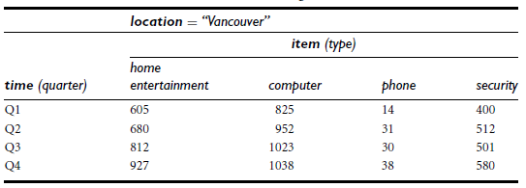
Example: Sales Data for AllElectronics
The 3-D data in the table are represented as a series of 2-D tables.
2-D View of Sales Data for AllElectronics According to time and item

Slide 41
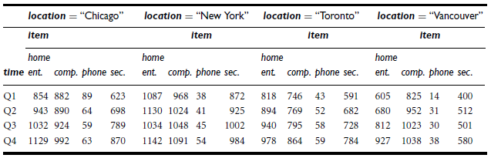
Example: Sales Data for AllElectronics
3-D View of Sales Data for All Electronics According to time, item, and location

Slide 42
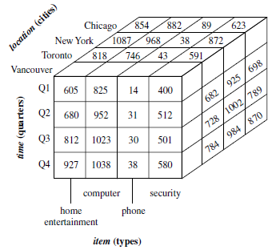
Example: Sales Data for AllElectronics
A 3-D data cube representation of the data in above table, according to time, item, and location.

Slide 43
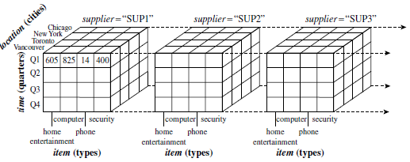
Example: Sales Data for AllElectronics
The 4-D cuboid is the base cuboid for the given time, item, location, and supplier dimensions.

Slide 44
schemas for multidimensional data model
Modeling data warehouses:
The entity-relationship data model is commonly used in the dimensions & measures of relational databases, where a database schema consists of a set of entities and the relationships between them.
The most popular data model for a data warehouse is a multidimensional model, which can exist in the form of a star schema, a snowflake schema, or a fact constellation schema.

Slide 45
schemas for multidimensional data model
Star schema: A fact table in the middle connected to a set of dimension tables
Snowflake schema: A refinement of star schema where some dimensional hierarchy is normalized into a set of smaller dimension tables, forming a shape similar to snowflake

Slide 46
schemas for multidimensional data model
Fact constellations:
Sophisticated applications may require multiple fact tables to share dimension tables. This kind of schema can be viewed as a collection of stars, and hence is called a galaxy schema or a fact constellation.

Slide 47
Example of Star Schema
Time
Dimension table
Item
Dimension table
time_key
day
day_of_the_week
month
quarter
year
item_key
item_name
brand
type
supplier_type
Sales
Fact Table
time_key
item_key
branch_key
Branch
Dimension table
Location
Dimension table
location_key
units_sold
location_key
street
city
state_or_province
country
branch_key
branch_name
branch_type
dollars_sold
avg_sales
Measures

Slide 48
Example of Star Schema
fact table
A large central table containing the bulk of the data, with no redundancy.
dimension tables
A set of smaller attendant tables, one for each dimension.
Note: The schema graph resembles a starburst, with the dimension tables displayed in a radial pattern around the central fact table.

Slide 49
Example of Snowflake Schema
Time
Dimension table
Item
Dimension table
time_key
day
day_of_the_week
month
quarter
year
item_key
item_name
brand
type
supplier_key
Supplier
Dimension table
Sales Fact Table
supplier_key
supplier_type
time_key
item_key
Location
Dimension table
Branch
Dimension table
branch_key
location_key
location_key
street
city_key
branch_key
branch_name
branch_type
units_sold
City
Dimension table
dollars_sold
city_key
city
state_or_province
country
avg_sales
Measures

Slide 50
Example of Fact Constellation
time
time_key
day
day_of_the_week
month
quarter
year
item
Shipping Fact Table
item_key
item_name
brand
type
supplier_type
Sales Fact Table
time_key
time_key
item_key
shipper_key
item_key
branch_key
from_location
branch
location_key
location
to_location
branch_key
branch_name
branch_type
units_sold
location_key
street
city
province_or_state
country
dollars_cost
dollars_sold
units_shipped
avg_sales
shipper
Measures
shipper_key
shipper_name
location_key
shipper_type

Slide 51
A Concept Hierarchy: Dimension (location)
all
all
region
Europe
...
North_America
country
Germany
...
Spain
Canada
...
Mexico
city
Frankfurt
...
Vancouver
...
Toronto
office
L. Chan
...
M. Wind

Slide 52
Data Cube Measures: Three Categories
Distributive: if the result derived by applying the function to n aggregate values is the same as that derived by applying the function on all the data without partitioning
E.g., count(), sum(), min(), max()
Algebraic: if it can be computed by an algebraic function with M arguments (where M is a bounded integer), each of which is obtained by applying a distributive aggregate function
E.g., avg(), min_N(), standard_deviation()
Holistic: if there is no constant bound on the storage size needed to describe a subaggregate.
E.g., median(), mode(), rank()

Slide 53
Multidimensional Data
Sales volume as a function of product, month, and region
Dimensions: Product, Location, Time
Hierarchical summarization paths
Region
Industry Region Year
Category Country Quarter
Product City Month Week
Office Day
Product
Month

Slide 54
Cuboids Corresponding to the Cube
all
0-D (apex) cuboid
product
date
country
1-D cuboids
product,date
product,country
date, country
2-D cuboids
3-D (base) cuboid
product, date, country

Slide 55
OLAP (online analytical processing)
OLAP (online analytical processing) is a computing method that enables users to easily and selectively extract and query data in order to analyze it from different points of view.
OLAP business intelligence queries often aid in trends analysis, financial reporting, sales forecasting, budgeting and other planning purposes.

Slide 56
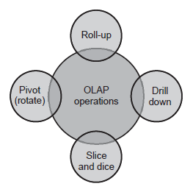
Typical OLAP Operations
4 Types of OLAP Operations

Slide 57
Typical OLAP Operations
Roll up (drill-up): summarize data
by climbing up hierarchy or by dimension reduction
Drill down (roll down): reverse of roll-up
from higher level summary to lower level summary or detailed data, or introducing new dimensions
Slice and dice: project and select

Slide 58
Typical OLAP Operations
Pivot (rotate):
reorient the cube, visualization, 3D to series of 2D planes
Other operations
drill across: involving (across) more than one fact table
drill through: through the bottom level of the cube to its back-end relational tables (using SQL)

Slide 59
Roll-up
Roll-up performs aggregation on a data cube in any of the following ways
By climbing up a concept hierarchy for a dimension
By dimension reduction
The result of a roll-up operation performed on the central cube by climbing up the concept hierarchy for location is
This hierarchy was defined as the total order “street <city < province or state < country.”

Slide 60
Example: Roll-up
The result of a roll-up operation performed on the central cube by climbing up the concept hierarchy for location is
This hierarchy was defined as the total order “street <city < province or state < country.”
The roll-up operation shown aggregates the data by ascending the location hierarchy from the level of city to the level of country.

Slide 61
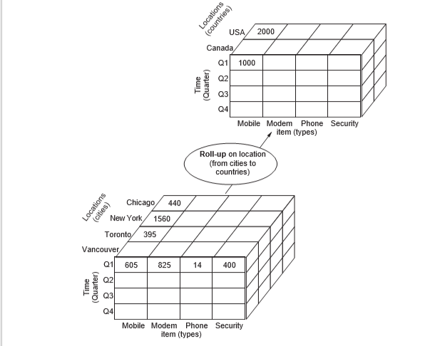

Slide 62
Drill-Down
Drill-down is the reverse of roll-up. It navigates from less detailed data to more detailed data. Drill-down can be realized by-
i) By stepping down a concept hierarchy for a
dimension.
ii) By introducing a new dimension.

Slide 63
Example: Drill-Down
Drill-down is performed by stepping down a concept hierarchy for the dimension time.
Initially the concept hierarchy was
"day < month < quarter < year."
On drilling down, the time dimension is descended from the level of quarter to the level of month.
When drill-down is performed, one or more dimensions from the data cube are added.
It navigates the data from less detailed data to highly detailed data.

Slide 64
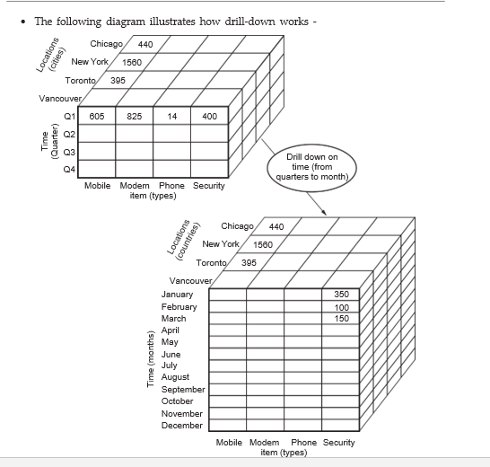

Slide 65
Slice
The slice operation selects one particular dimension from a given cube and provides a new sub-cube.
Here slice is performed for the dimension "time" using the criterion time = "Q1".
It will form a new sub-cube by selecting one or more dimensions.

Slide 66
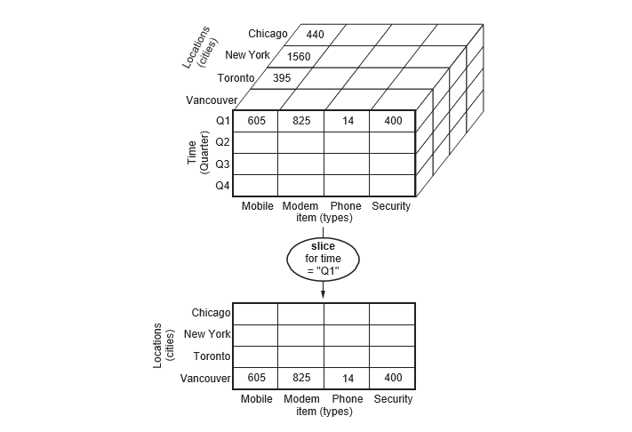
Pictorial view of Slice operation

Slide 67
Dice
Dice selects two or more dimensions from a given cube and provides a new sub-cube.
The dice operation on the cube based on the following selection criteria involves three dimensions.
(location = "Toronto" or "Vancouver")
(time = "Q1" or "Q2")
(item =" Mobile" or "Modem")

Slide 68
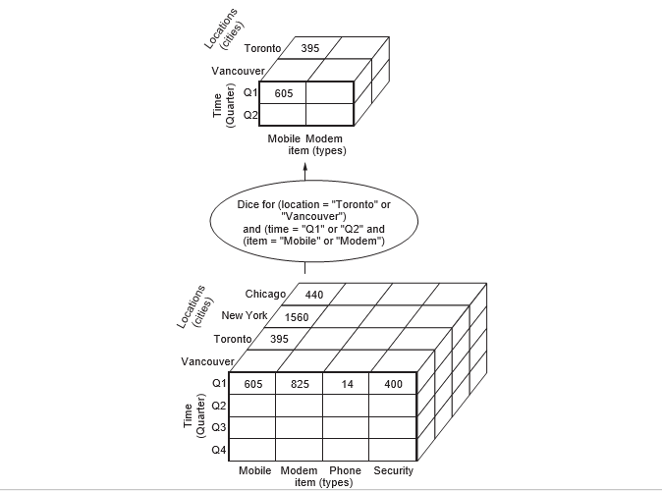
Pictorial view of Dice operation

Slide 69
Pivot
The pivot operation is also known as rotation.
It rotates the data axes in view in order to provide an alternative presentation of data.
Consider the following diagram that shows the pivot operation.

Slide 70
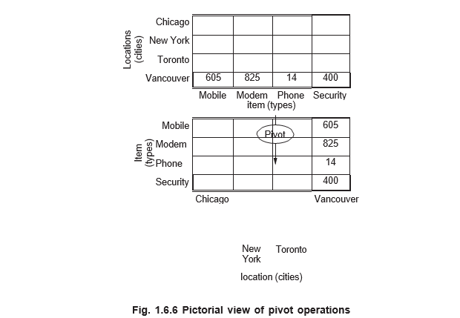
Pictorial view of Pivot operation

Slide 71
OLAP Server Architectures
Relational OLAP (ROLAP)
Use relational or extended-relational DBMS to store and manage warehouse data and OLAP middle ware
Include optimization of DBMS backend, implementation of aggregation navigation logic, and additional tools and services
Greater scalability
Multidimensional OLAP (MOLAP)
Sparse array-based multidimensional storage engine
Fast indexing to pre-computed summarized data
Hybrid OLAP (HOLAP) (e.g., Microsoft SQLServer)
Flexibility, e.g., low level: relational, high-level: array

Slide 72
Summary
Data mining: Discovering interesting patterns and knowledge from massive amount of data
Data Warehouse Architecture, Design, and Usage
Multi-tiered architecture
Business analysis design framework
Data warehousing: A multi-dimensional model of a data warehouse
A data cube consists of dimensions & measures
Star schema, snowflake schema, fact constellations
OLAP operations: drilling, rolling, slicing, dicing and pivoting

Slide 73
NPTEL Video Link
http://www.digimat.in/nptel/courses/video/106106093/L32.html

Slide 74
Recommended Reference Books
S. Chakrabarti. Mining the Web: Statistical Analysis of Hypertex and Semi-Structured Data. Morgan Kaufmann, 2002
R. O. Duda, P. E. Hart, and D. G. Stork, Pattern Classification, 2ed., Wiley-Interscience, 2000
T. Dasu and T. Johnson. Exploratory Data Mining and Data Cleaning. John Wiley & Sons, 2003
U. M. Fayyad, G. Piatetsky-Shapiro, P. Smyth, and R. Uthurusamy. Advances in Knowledge Discovery and Data Mining. AAAI/MIT Press, 1996
U. Fayyad, G. Grinstein, and A. Wierse, Information Visualization in Data Mining and Knowledge Discovery, Morgan Kaufmann, 2001
J. Han and M. Kamber. Data Mining: Concepts and Techniques. Morgan Kaufmann, 3rd ed., 2011
D. J. Hand, H. Mannila, and P. Smyth, Principles of Data Mining, MIT Press, 2001
T. Hastie, R. Tibshirani, and J. Friedman, The Elements of Statistical Learning: Data Mining, Inference, and Prediction, 2nd ed., Springer-Verlag, 2009
B. Liu, Web Data Mining, Springer 2006.
T. M. Mitchell, Machine Learning, McGraw Hill, 1997
G. Piatetsky-Shapiro and W. J. Frawley. Knowledge Discovery in Databases. AAAI/MIT Press, 1991
P.-N. Tan, M. Steinbach and V. Kumar, Introduction to Data Mining, Wiley, 2005
S. M. Weiss and N. Indurkhya, Predictive Data Mining, Morgan Kaufmann, 1998
I. H. Witten and E. Frank, Data Mining: Practical Machine Learning Tools and Techniques with Java Implementations, Morgan Kaufmann, 2nd ed. 2005

